Slide 1
National Voters’ Services Portal (NVSP- EVP)
Aug 27, 2019

Slide 2
National Voters’ Services Portal (NVSP)
National Voters’ Services Portal services portal (NVSP) was launched on National Voters’ Day (25.01.2015).
National Voters Service Portal aims to provide single window quality services through user-friendly interface for citizen to increase transparency and ease of access of information.
It acts as a container to all the citizen services envisaged under the electoral registration.
The portal UI is responsive in nature which caters to both desktop and mobiles.

Slide 3
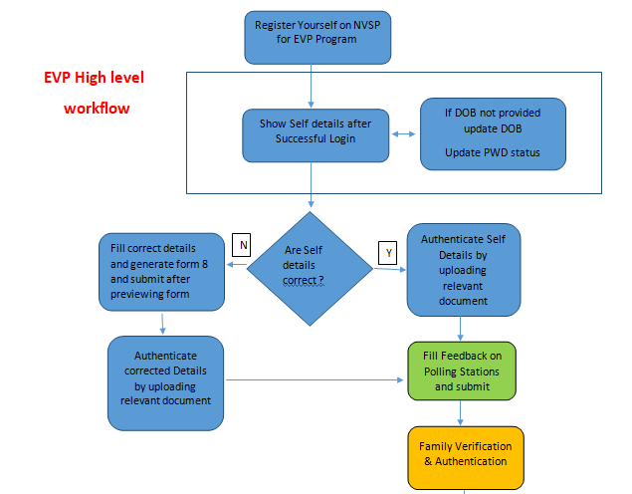
continue

Slide 4
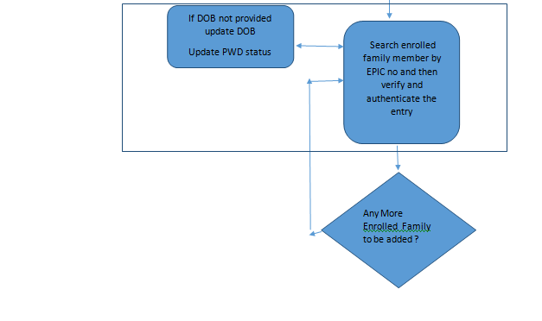
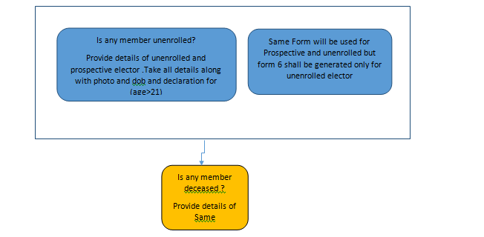

Slide 5
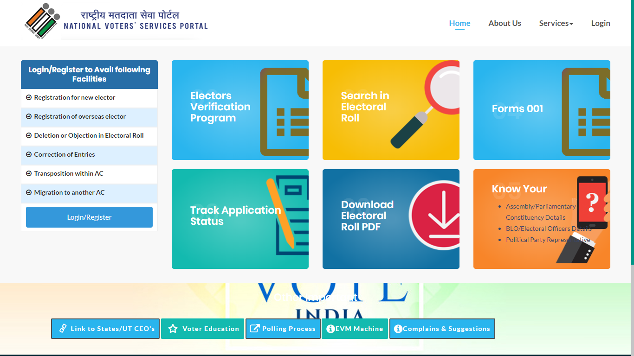
National Voters’ Services Portal (NVSP)

Slide 6
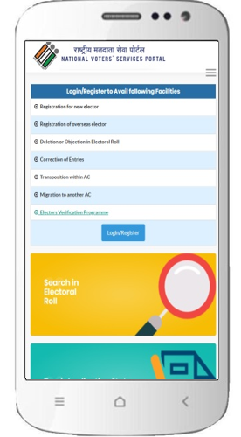
NVSP-Mobile Version(EVP)
The portal UI is responsive in nature which caters to both desktop and mobiles.
Easy access
Optimized for users
App-like experience
Multi-language support

Slide 7
Citizen Services through NVSP
Search your name in electoral roll
Track application status
Request for duplicate EPIC
Know your ERO/BLO Details
Download Electoral Roll
Know your AC/PC
Privileged Services for Registered Users (EVP)

Slide 8
Citizen Services through NVSP
Registration for new elector
Registration of overseas elector
Deletion or Objection in Electoral Roll
Correction of Entries
Polling Station Details
Transposition within AC
Migration to another AC
Elector Verification Program
Verification of Details
Family Tagging
PwD/ASD Marking
Feedback on Polling Station

Slide 9
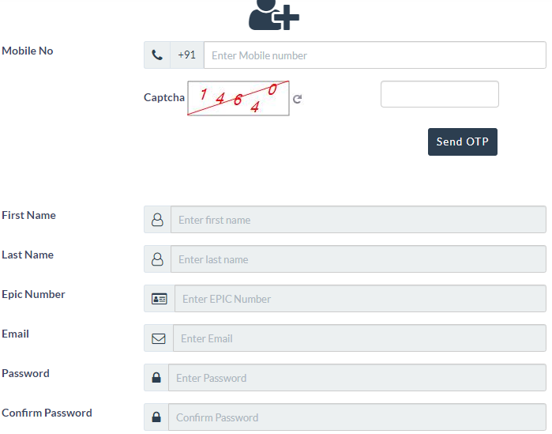
Registered User – Electors
Information needs to be filled by Electors for EVP Registration on NVSP

Slide 10
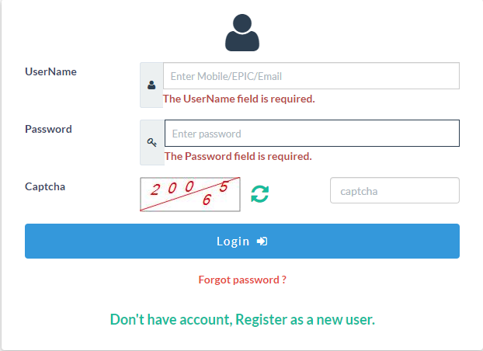
Login Screen for Registered Electors

Slide 11
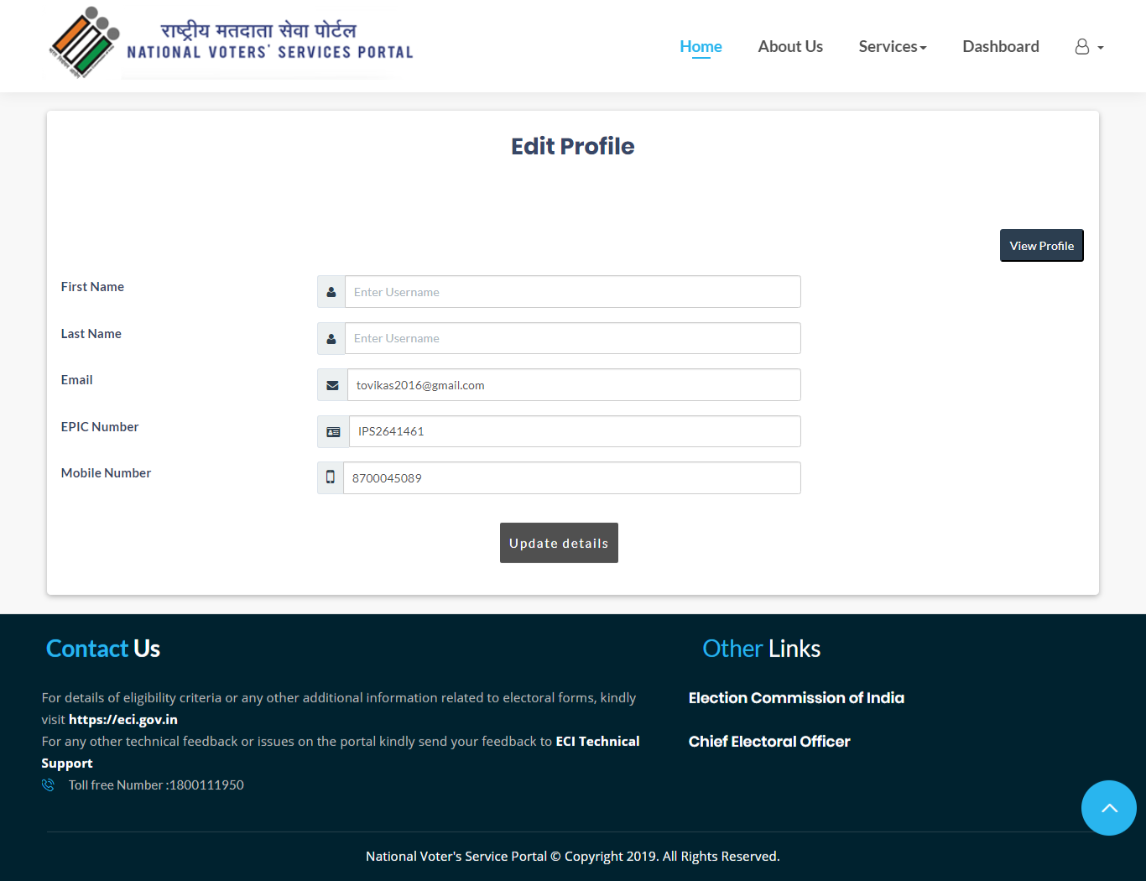
Registered User – Electors
My Profile - User can view/Edit the basic details related to his profile.

Slide 12
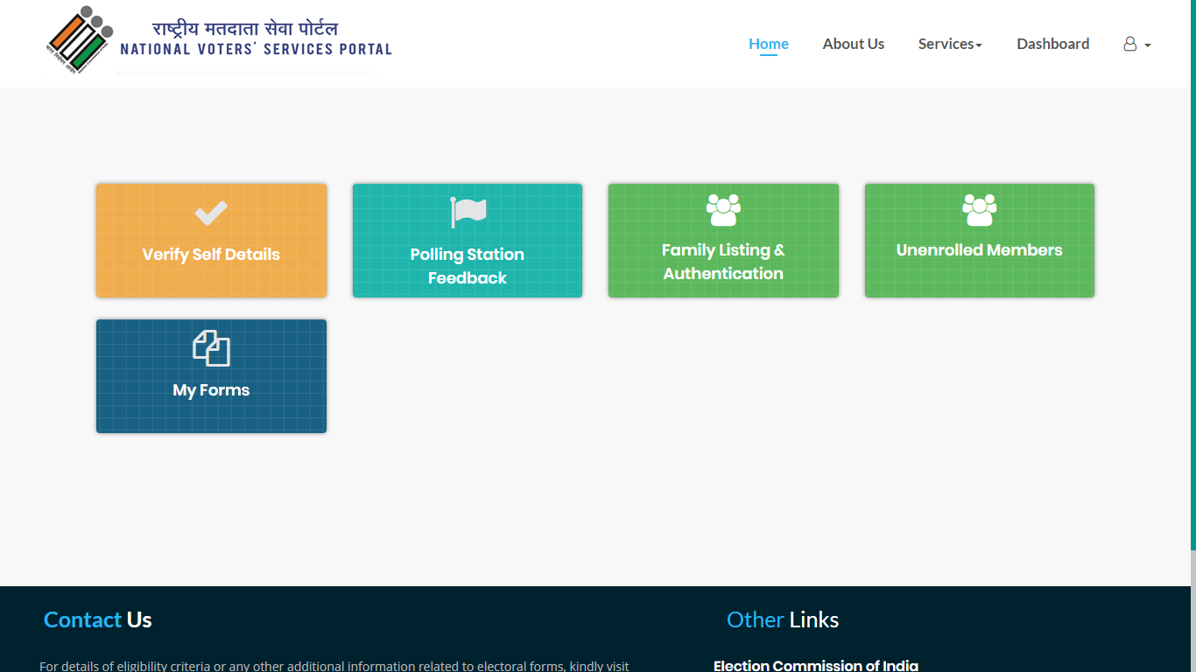
Registered User – Electors
Electors Verification Programme (EVP)

Slide 13
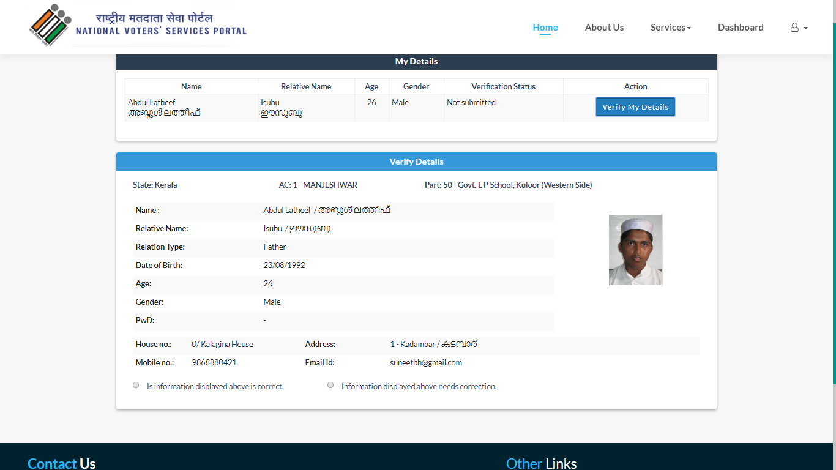
Registered User – Electors (self verification)
Verification of details
User can check, verify and correct elector’s personal details.

Slide 14
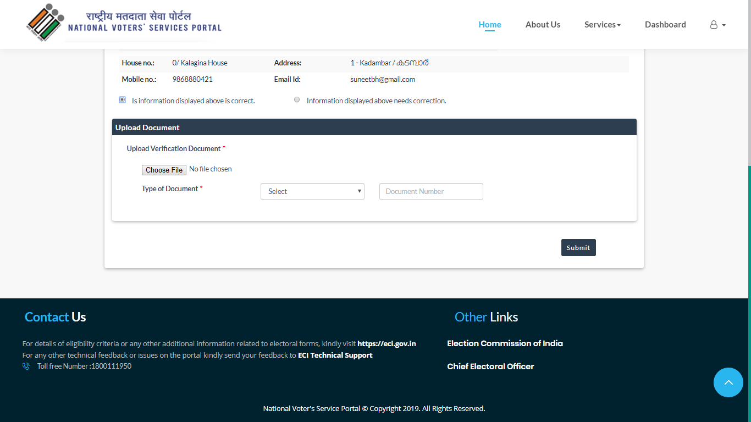
Registered User – Electors (self verification)
Verification of details
User can verify by uploading a document and entering the documents number.

Slide 15
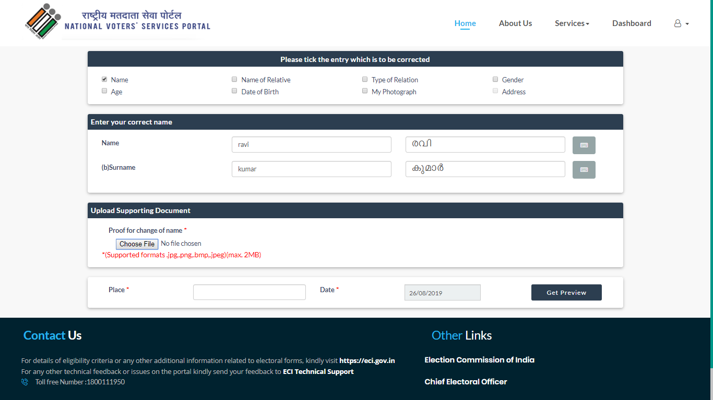
Registered User – Electors (self verification)
Correction of details
User can correct personal details & upload supporting documents

Slide 16
Registered User – Electors (self verification)

Slide 17
Polling Station Suggestions

Slide 18
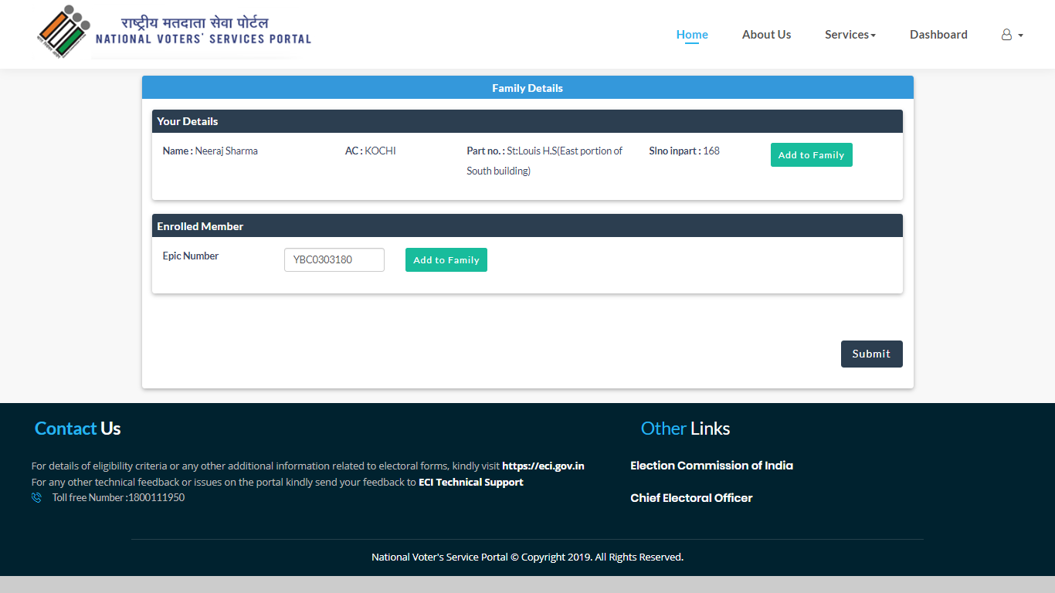
Registered User – Electors
Family Grouping–
Elector will search his family detail by EPIC number on NVSP them together as Family.

Slide 19
Thank You
Support: ecitechsupport@eci.gov.in

